Slide 1
Part 1: Python basic

Slide 2
CONTENTS
2
Part 1: Python basics
Getting Started with Jupyter Notebook
Variables and simple data types
Introducing lists, Tuples, Sets and Dictionaries
Conditional Statements and While loop
Function and class (OOP)

Slide 3
Functions
5.1. Functions
What are functions?
Defining a Function
Passing Arguments
Return Values
Passing a List
Passing an Arbitrary Number of Arguments
Modules

Slide 4
What are functions?
Functions are named blocks of code designed to do one specific job.
Functions allow you to write code once that can then be run whenever you need to accomplish the same task.
Functions can take in the information they need, and return the information they generate.
Using functions effectively makes your programs easier to write, read, test, and fix.

Slide 5
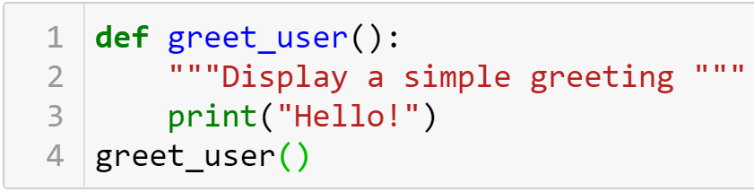

Defining a Function
The simplest structure of a function
keyword
The name of the function
Defining
Docstring
Body
Describes what the function does
Calling

Slide 6
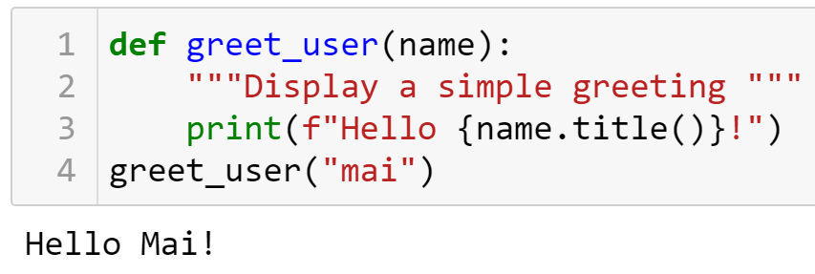


Defining a Function
Passing Information to a Function
Arguments and Parameters
Parameter
Argument

Slide 7
Practice
8-1,8-2

Slide 8
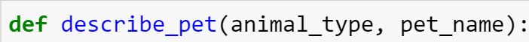
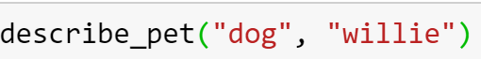
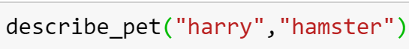
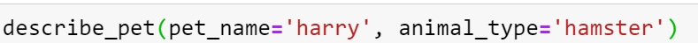
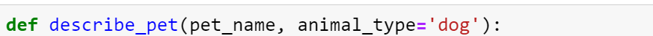
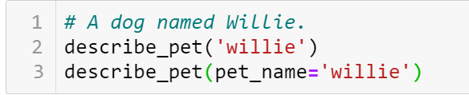
Passing Arguments
Positional Arguments
Using keyword arguments
Default Values
Equivalent Function Calls

Slide 9

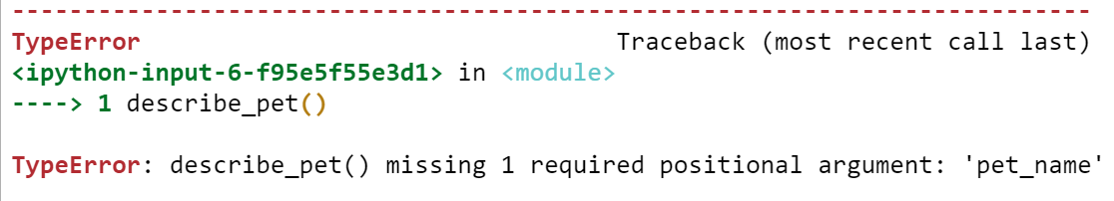
Passing Arguments
Avoiding Argument Errors

Slide 10
Practice
8-3,…,8-5

Slide 11
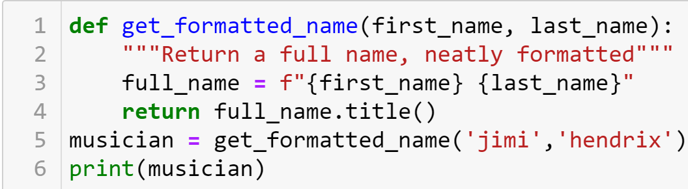

Return Values
Returning a Sinple Value

Slide 12
Return Values
A function can return a value or a set of values. When a function returns a value, the calling line should provide a variable which the return value can be assigned to.
A function stops running when it reaches a return statement.

Slide 13
Visualizing functions
http://pythontutor.com/

Slide 14
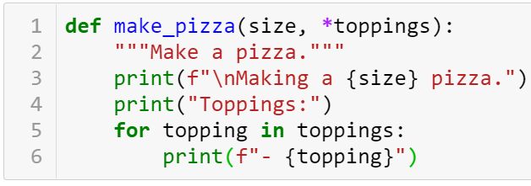
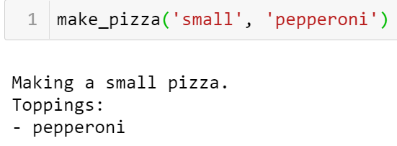
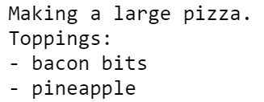
Passing an Arbitrary Number of Arguments
Sometimes you won't know how many arguments a function will need to accept. Python allows you to collect an arbitrary number of arguments into one parameter using the * operator .
A parameter that accepts an arbitrary number of arguments must come last in the function definition.
Collecting an arbitrary number of arguments

Slide 15
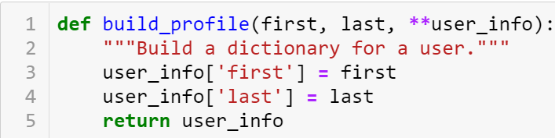
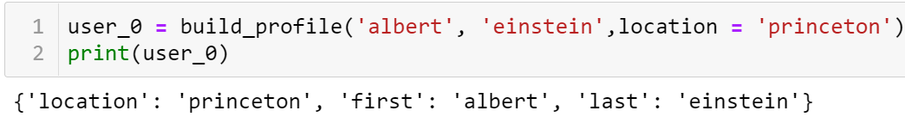
Passing an Arbitrary Number of Arguments
Collecting an arbitrary number of keyword arguments
The ** operator allows a parameter to collect an arbitrary number of keyword arguments.
These arguments are stored as a dictionary with the parameter names as keys, and the arguments as values.

Slide 16
Order of parameters
Normal parameters
*args
Parameters have default values
**kwargs

Slide 17
Practice
Exercise 1: Filter Prime Numbers using *args
Write a function that accepts n positive integers using *args to get a tuple of integers. The function will return a new list containing the prime numbers from the original list.
Exercise 2: Student Assessment
Write a function that takes a student's name and a list of scores via **kwargs and calculates the average of that student's scores.
Ex: student_info = {'name': 'Alice', 'scores': [85, 90, 92]}
calculate_average_score(** student_info)=?

Slide 18
Modules
Storing a function in a module
Importing an entire module
Importing a specific function
Giving a module an alias
Importing all functions from a module Don't do this, but recognize it when you see it in others' code. It can result in naming conflicts, which can cause errors.

Slide 19
Practice

Slide 20
Classes
5.2. Classes
What are classes?
Creating and using a class
Working with Classes and Instances
Inheritance
Importing Classes

Slide 21
What are classes?
Classes are the foundation of object-oriented programming.
Classes represent real-world things you want to model in your programs: for example: dogs, cars, and robots….
You use a class to make objects, which are specific instances of dogs, cars, and robots.
A class defines the general behavior that a whole category of objects can have, and the information that can be associated with those objects.
Classes can inherit from each other – you can write a class that extends the functionality of an existing class. This allows you to code efficiently for a wide variety of situations.

Slide 22

Creating and using a class
Creating the Dog Class
Name
Age
Weight
Sit
Roll over

Slide 23
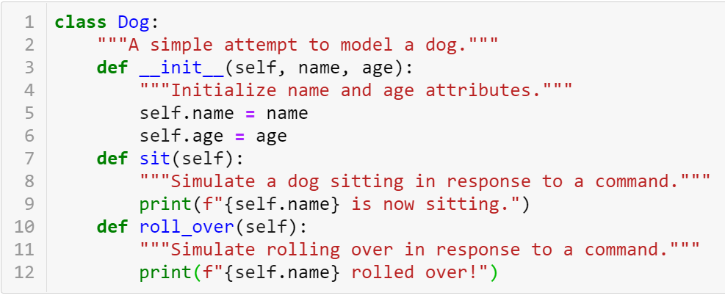

Creating and using a class
Creating the Dog Class
define a class called Dog
docstring
Method
attributes
The __init__() Method is a special method that Python runs automatically whenever we create a new instance based on the Dog class

Slide 24


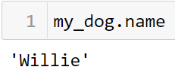
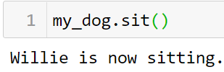
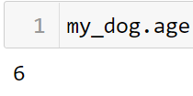


Creating and using a class
Making an Instance from a Class
Accessing Attributes
Calling Methods
Creating Multiple instances

Slide 25
Practice
Exercise: Email Class with Methods
Create an Email class with the following attributes: email_address (the email address of the user), inbox (a list to store received emails), and sent (a list to store sent emails). Implement the following methods for the class:
Method __init__(self, email_address): Initialize an Email object with the given email_address. Initialize inbox and sent lists as empty lists.
Method send(self, recipient, message): Create an email with the given message and send it to the specified recipient. Add the sent email to the sent list of the sender and add the email to the recipient's inbox.
Method read(self): Print all the emails in the inbox.
Method delete(self, index): Delete the email at the specified index from the inbox.

Slide 26
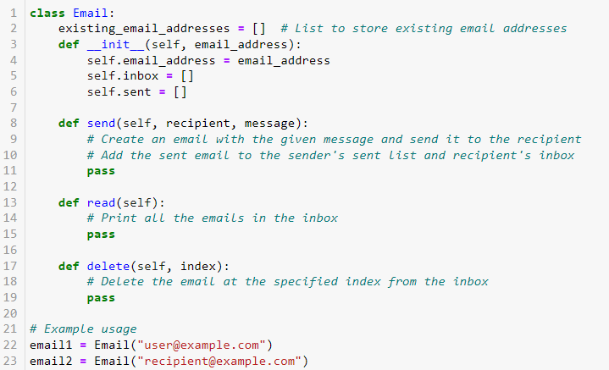
Here's a sample template to help you get started:

Slide 27
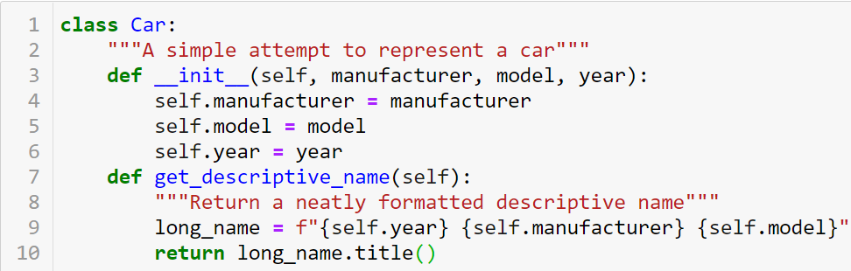
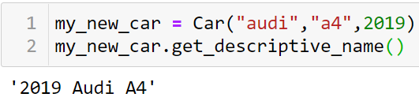
Working with Classes and Instances
The Car Class

Slide 28
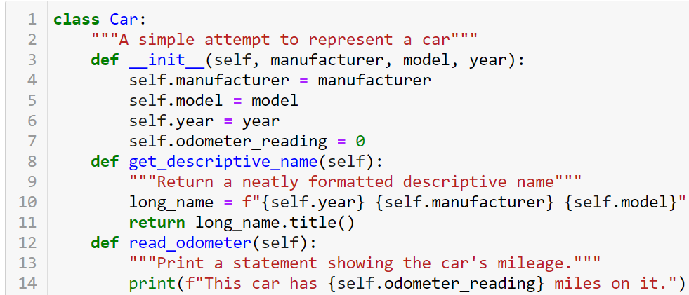
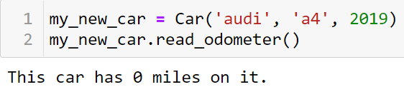
Working with Classes and Instances
Setting a Default Value for an Attribute

Slide 29
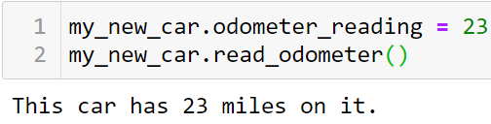
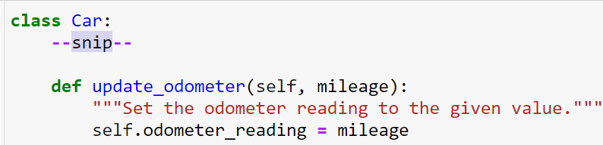
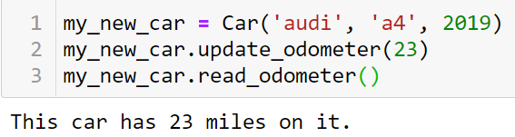
Working with Classes and Instances
Modifying Attribute Values
Modifying an Attribute’s Value Directly
Modifying an Attribute’s Value Through a Method

Slide 30
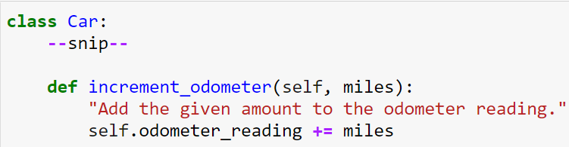
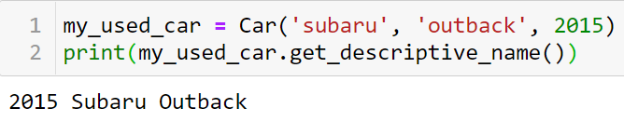
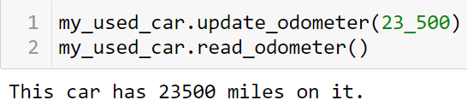
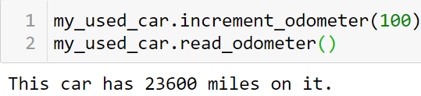
Working with Classes and Instances
Incrementing an Attribute’s Value Through a Method

Slide 31
Special Methods
All the built-in data types implement a collection of special object methods.
The names of special methods are always preceded and followed by double underscores (__).
Reference: https://www.pythonlikeyoumeanit.com/Module4_OOP/Special_Methods.html

Slide 32
Inheritance
You don’t always have to start from scratch when writing a class. If the class you’re writing is a specialized version of another class you wrote, you can use inheritance.
When one class inherits from another, it takes on the attributes and methods of the first class.
The original class is called the parent class, and the new class is the child class.
The child class can inherit any or all of the attributes and methods of its parent class, but it’s also free to define new attributes and methods of its own.

Slide 33
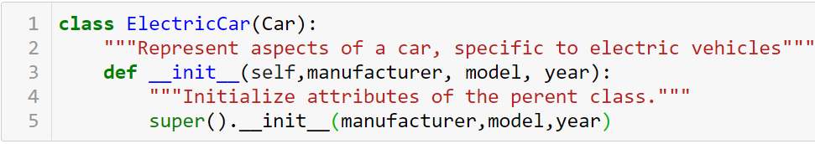
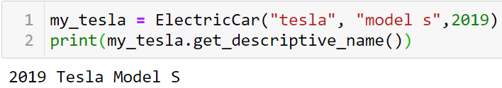
Inheritance
The __init__() Method for a Child Class
Name of parent class
define the child class
takes in the information required to make a Car instance
tells Python to call the __init__() method from Car, which gives an ElectricCar instance all the attributes defined in that method.
special function that allows you to call a method from the parent class

Slide 34
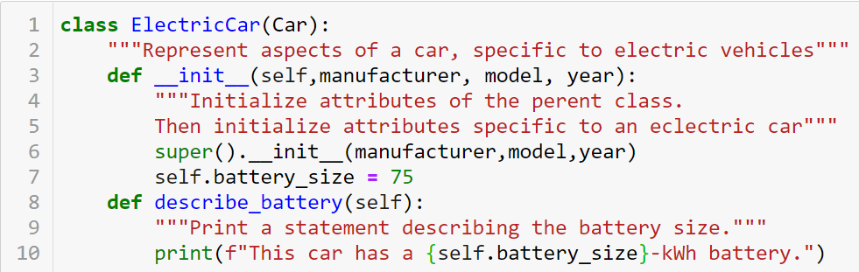
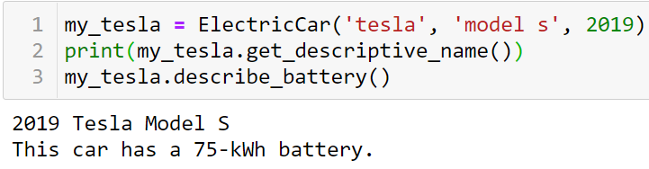
Inheritance
Defining Attributes and Methods for the Child Class

Slide 35
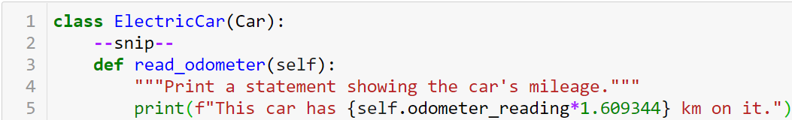
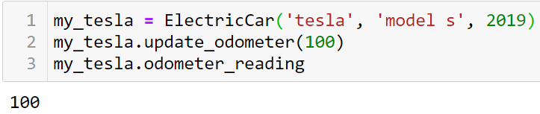

Inheritance
Overriding Methods from the Parent Class

Slide 36
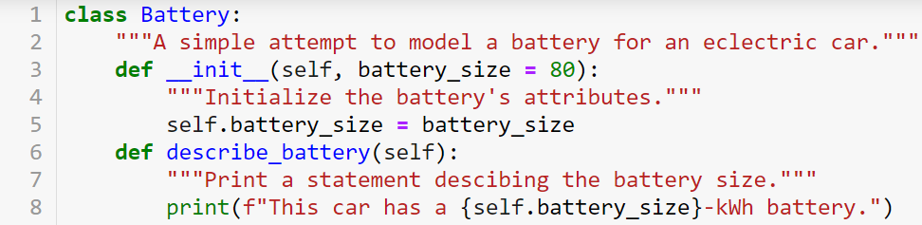
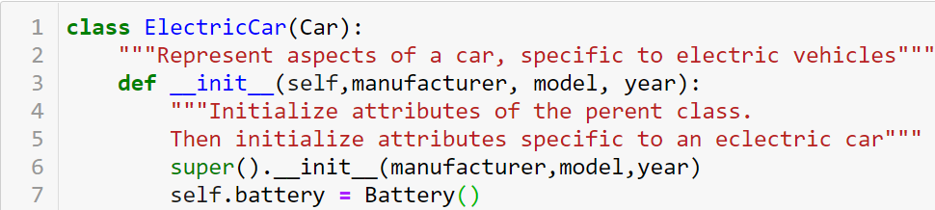
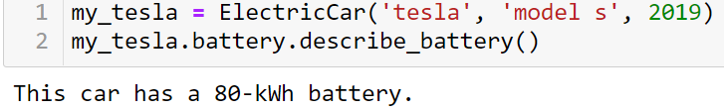
Inheritance
Instances as Attributes

Slide 37
Practice
9-6,…,9-9

Slide 38


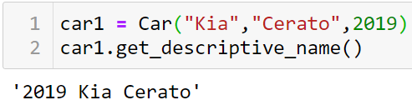
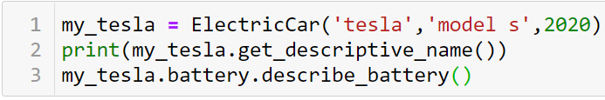
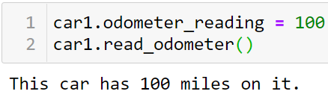

Importing Classes
Importing a Single Class
Storing Multiple Classes in a Module

Slide 39
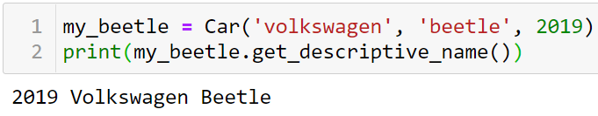
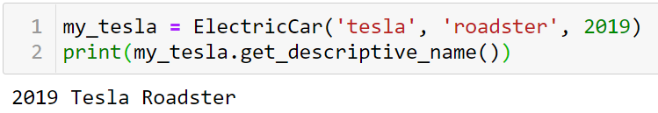

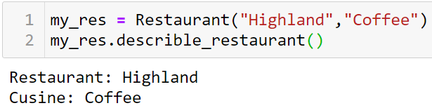
Importing Classes
Importing Multiple Classes from a Module
Importing Multiple Classes from a Module

Slide 40
Importing Classes
Importing Multiple Classes from a Module
Importing Multiple Classes from a Module

Slide 41
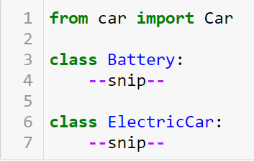


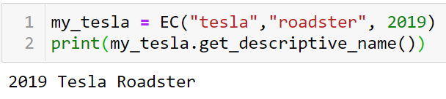
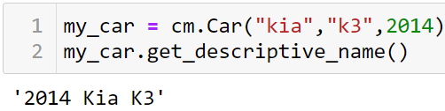
Importing Classes
Importing a Module into a Module
Using Aliases

